Slide 1
Air & Space System Capabilities

Slide 2
Overview
Selected air and space systems used in AFEX wargame
A. Mission
B. Characteristics

Slide 3
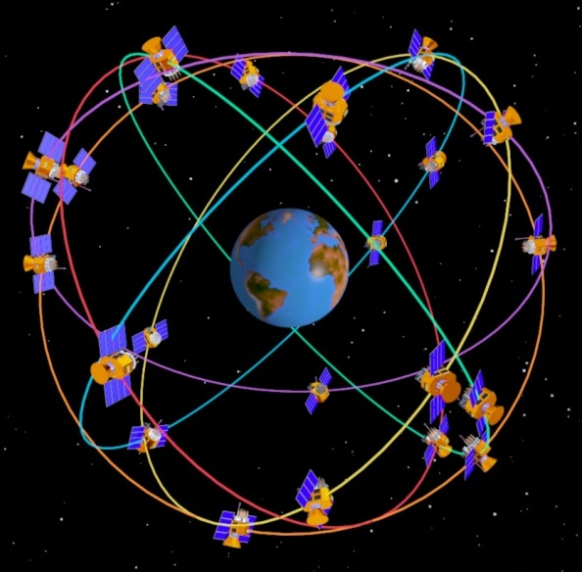
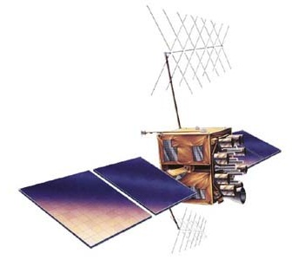
Global Positioning System (GPS)
Positioning, Navigation, Timing
and Velocity Information

Slide 4
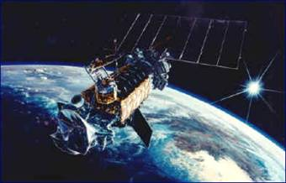
Defense Meteorological Satellite Program
Visual and Infrared Imagery
of Weather Systems

Slide 5
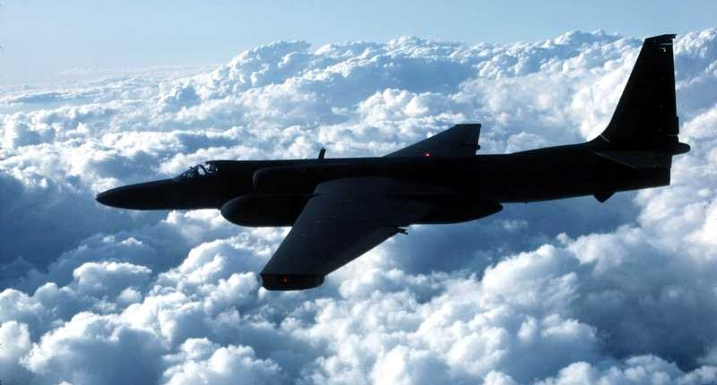
U-2S Dragon Lady
High Altitude Reconnaissance

Slide 6
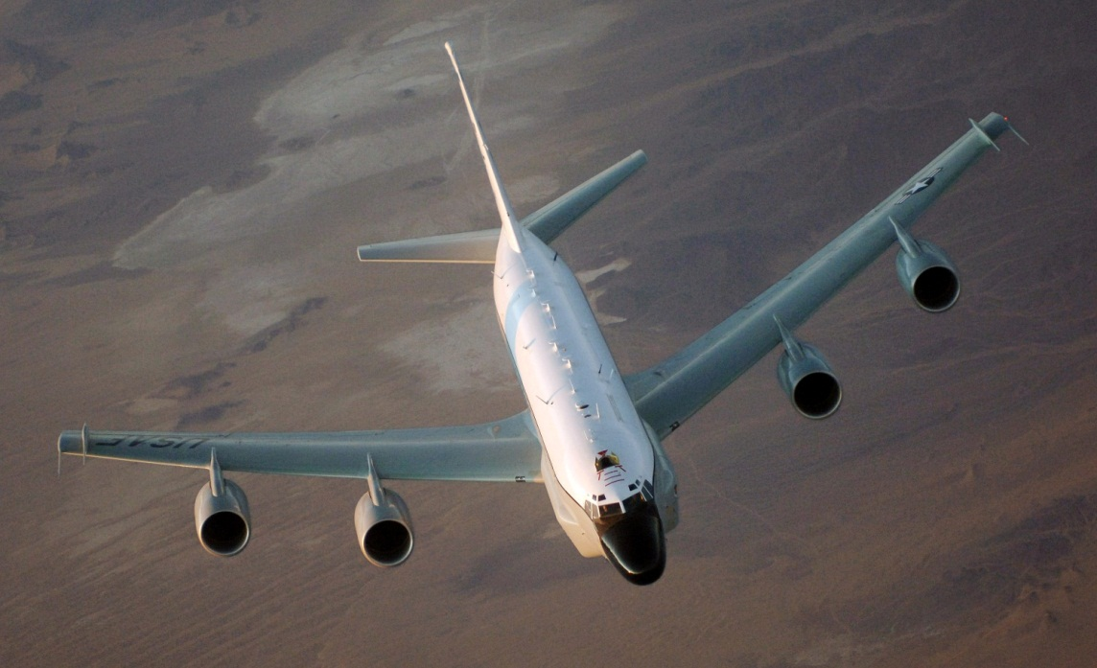
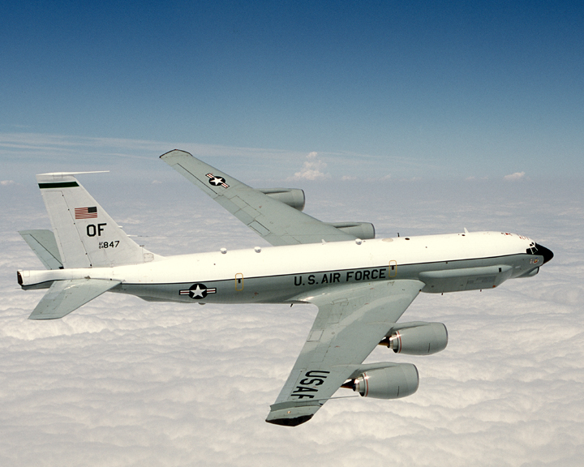
RC-135
Reconnaissance
"Rivet Joint”
"Combat Sent"
“Cobra Ball”

Slide 7
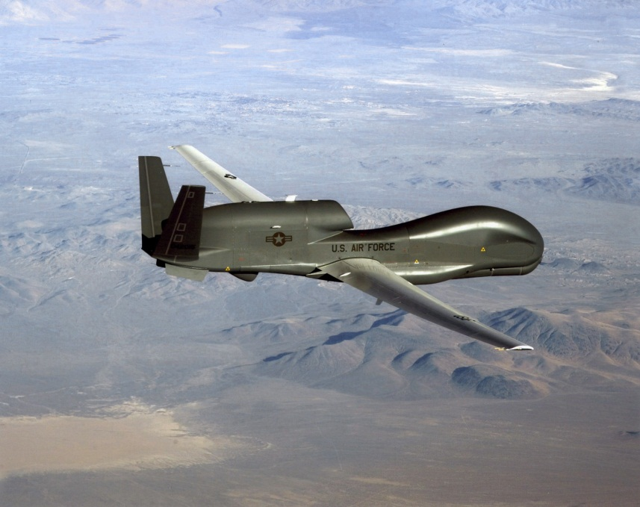
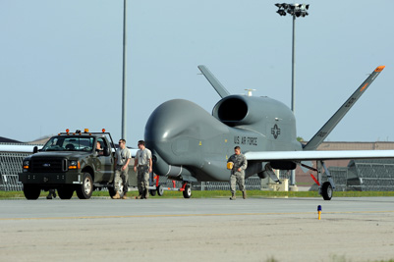
RQ-4 Global Hawk
Remotely-Piloted
Reconnaissance

Slide 8
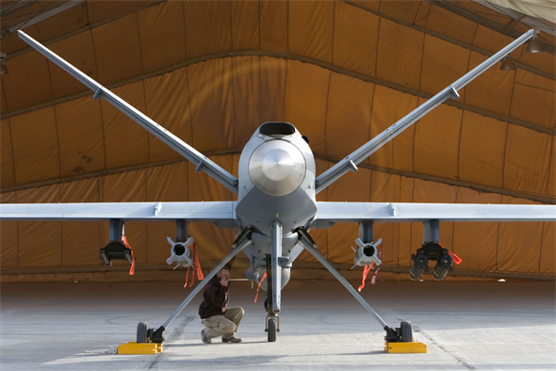
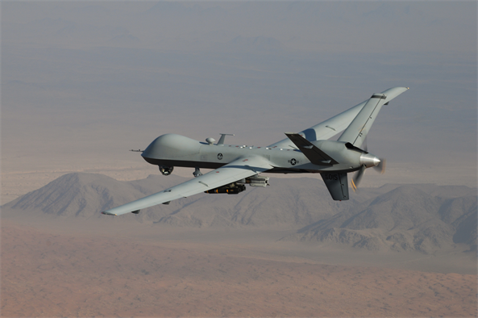
MQ-9 Reaper
Intelligence-Collection
Strike Against Time-Sensitive Targets

Slide 9
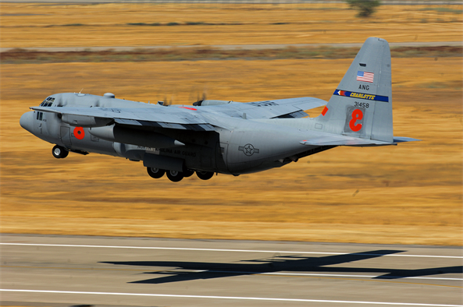
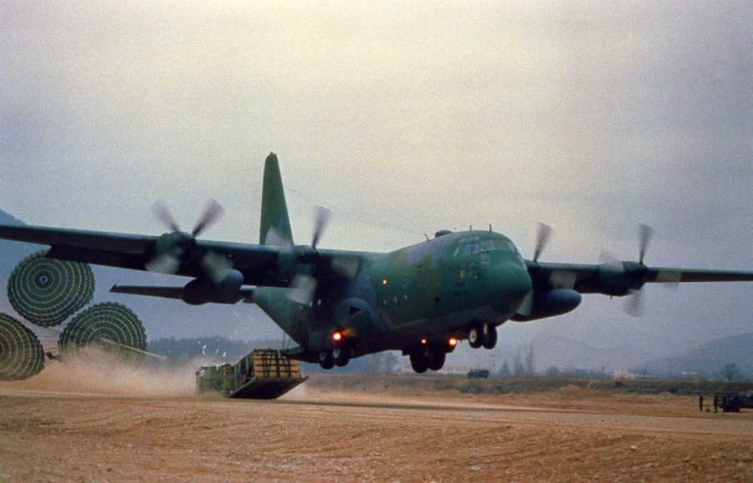
C-130 Hercules
Intratheater Airlift

Slide 10
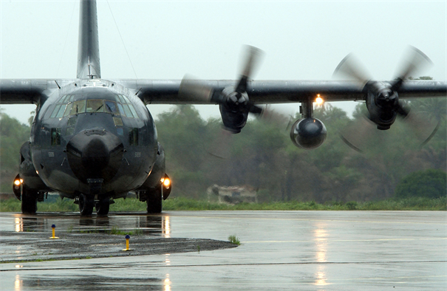
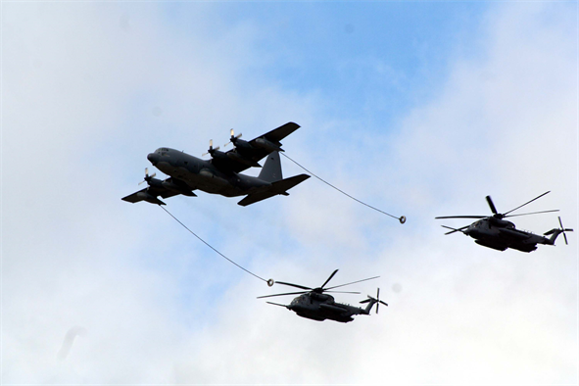
MC-130P Combat Shadow
Air Refueling and Rescue

Slide 11
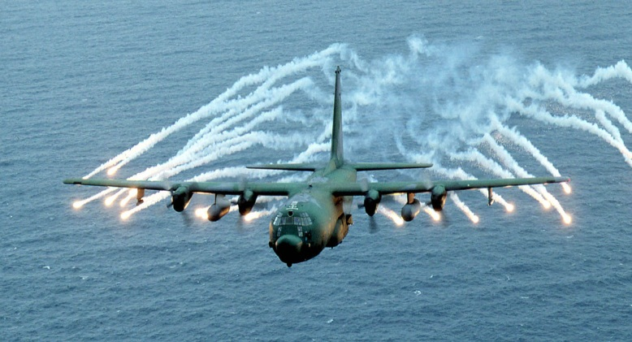
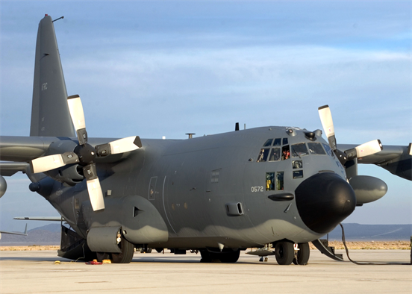
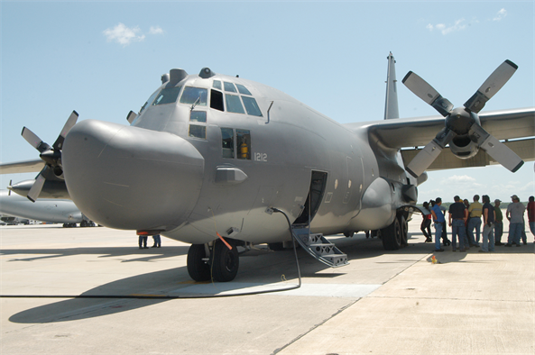
MC-130E/H Combat Talon
Accompany Special Forces
Carry Larger Equipment
MC-130E
MC-130H

Slide 12
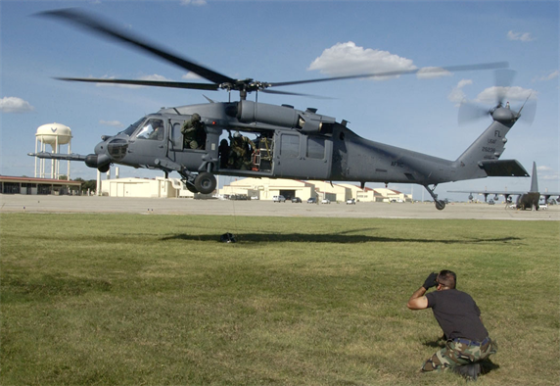
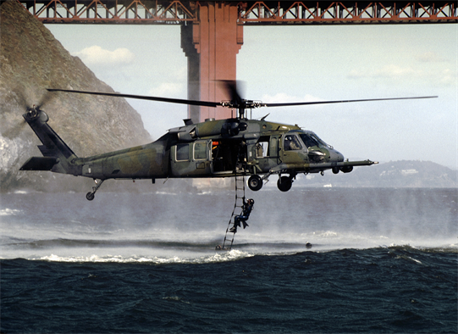
HH-60G Pave Hawk
Day/Night/All-Weather
Special Ops / CSAR

Slide 13
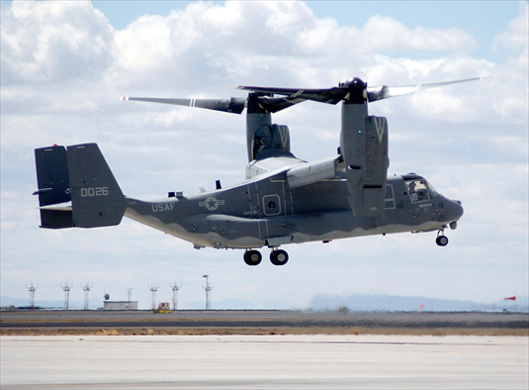
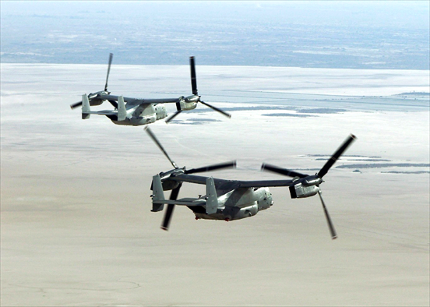
CV-22 Osprey
Tiltrotor with Vertical Takeoff,
Hover, and Vertical Landing

Slide 14
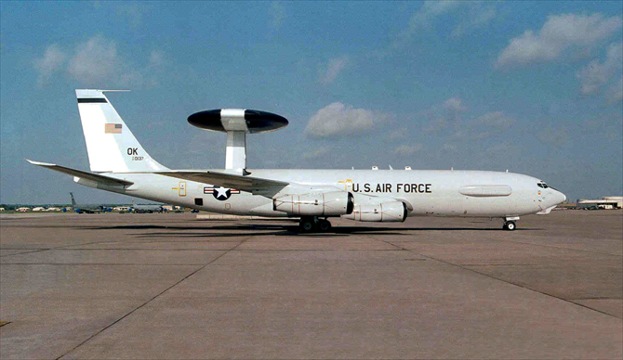
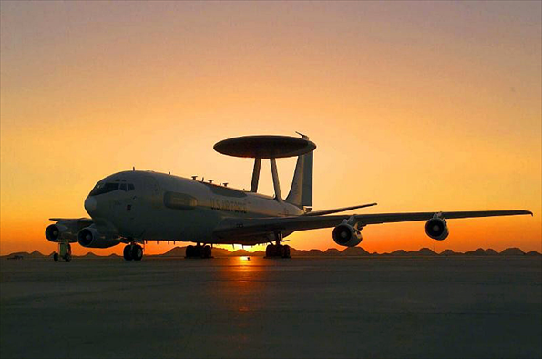
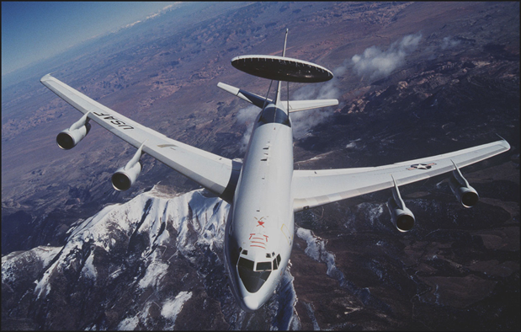
E-3 Sentry/AWACS
Surveillance, Identify & Track, Air Battle Management

Slide 15
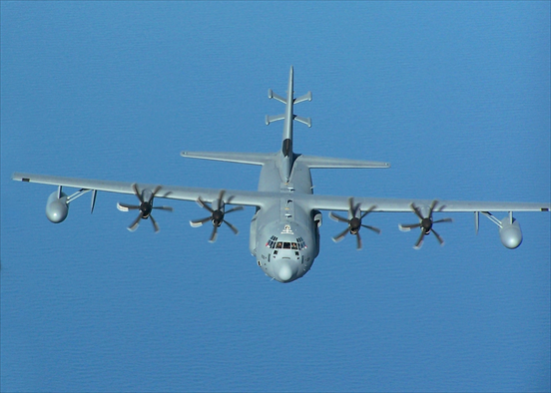
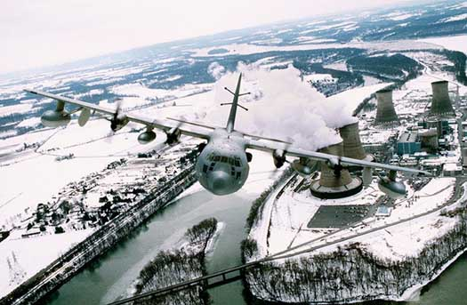
EC-130J Commando Solo
TV and radio station
PSYOPs
Air National Guard

Slide 16
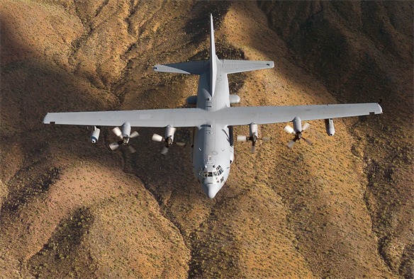
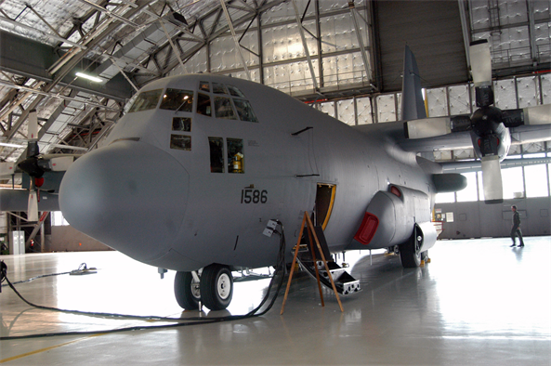
EC-130H Compass Call
Information Operations
Jamming

Slide 17
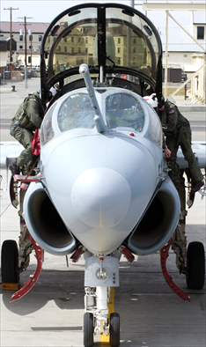
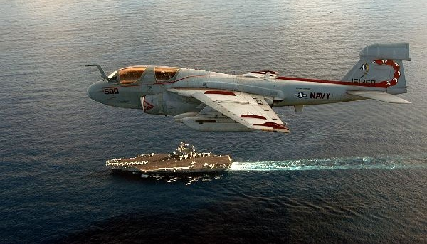
EA-6B Prowler
Air Superiority Enhancement
Electronic Countermeasures
SEAD

Slide 18
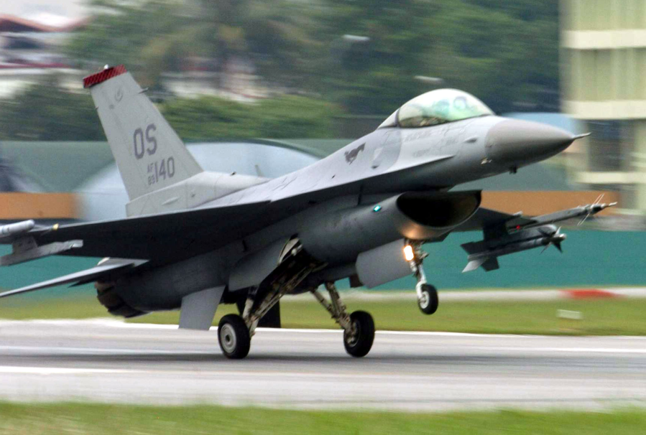
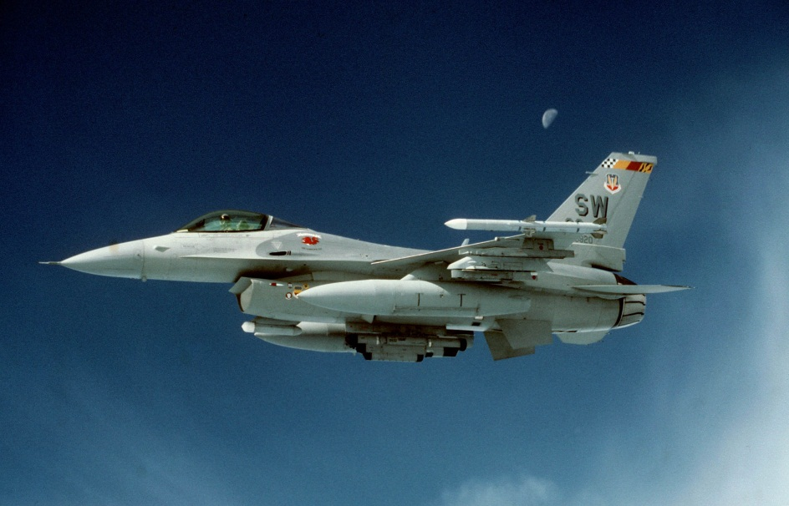
F-16 Falcon
Multi-Role
Highly Maneuverable
Gulf War Workhorse

Slide 19
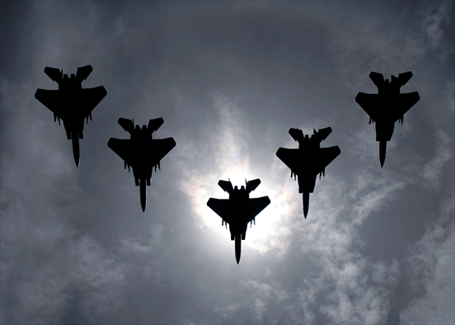
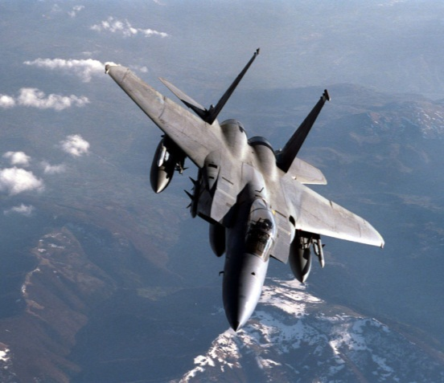
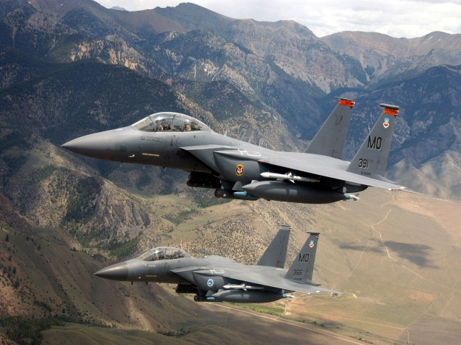
F-15 Eagle
Air Superiority
Powerful Radar
Outstanding Combat Record
F-15C Air-to-Air
F-15E
Multi-role / Air-to-Ground

Slide 20
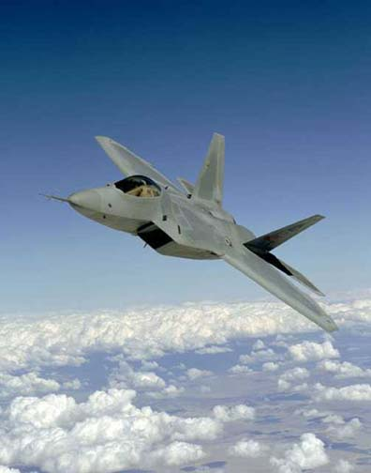
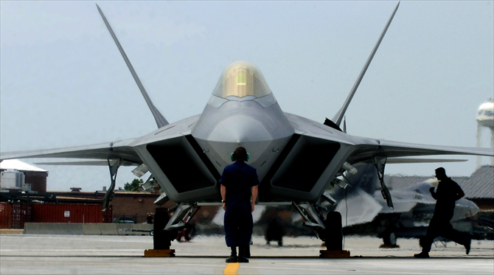
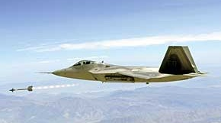
F-22 Raptor
Air Dominance Fighter
(Surface Attack, Escort, Sweep)

Slide 21
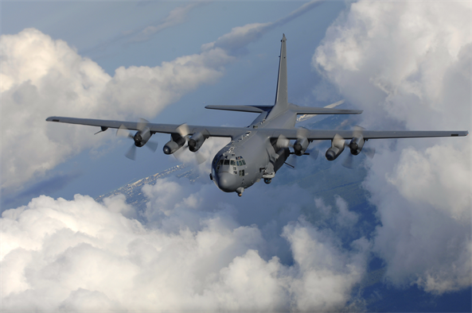
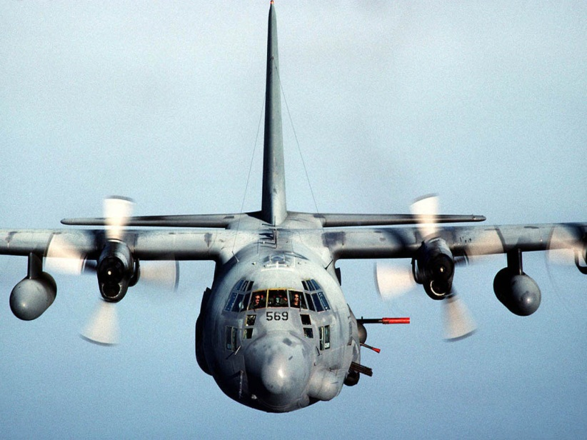
AC-130H Spectre
Close Air Support
Air Interdiction

Slide 22
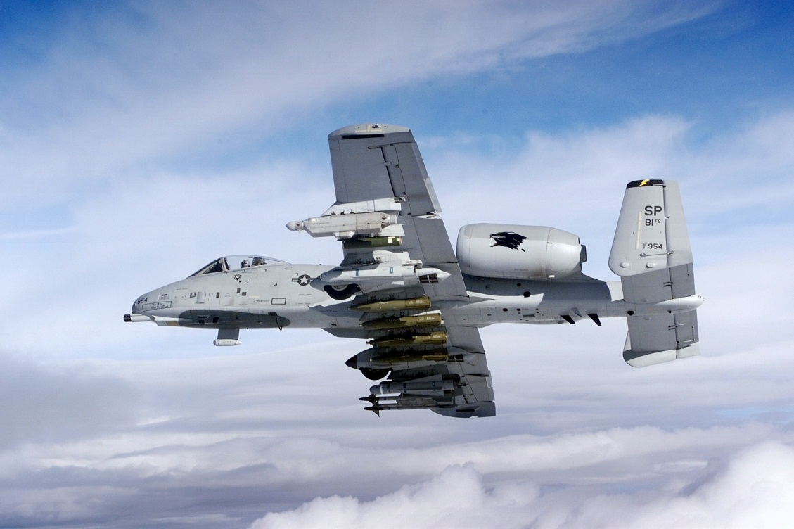
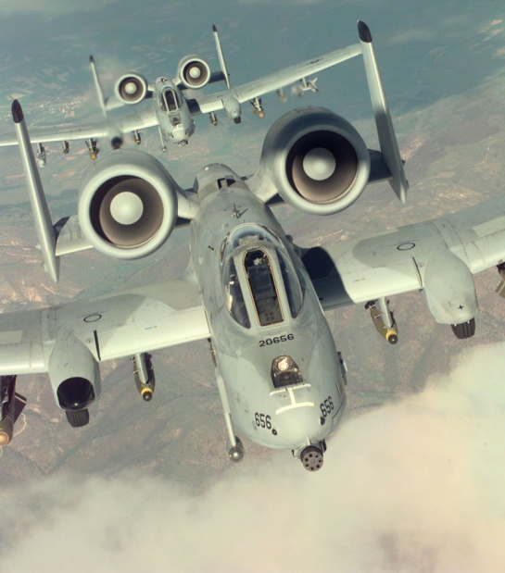
A-10 Thunderbolt II
Close Air Support
Forward Air Controller
30 mm Cannon

Slide 23
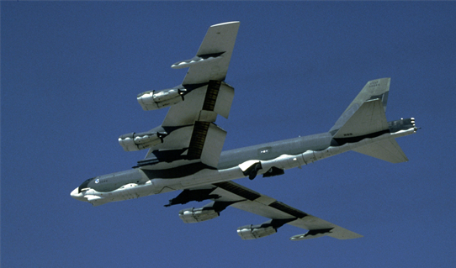
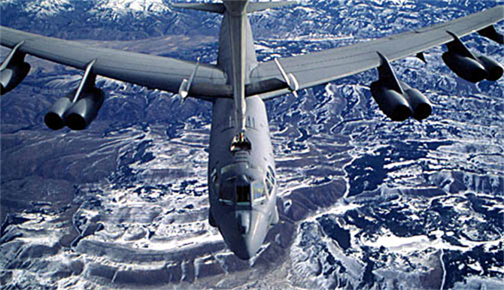
B-52 Stratofortress
Long-Range, Heavy Bomber
Backbone of Strategic Bomber Force

Slide 24
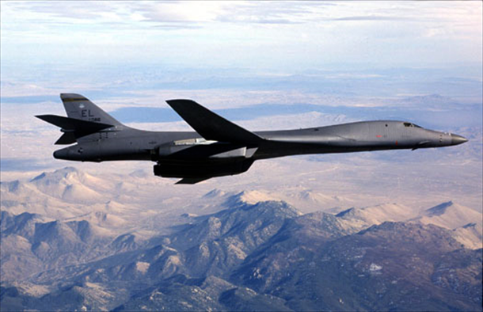
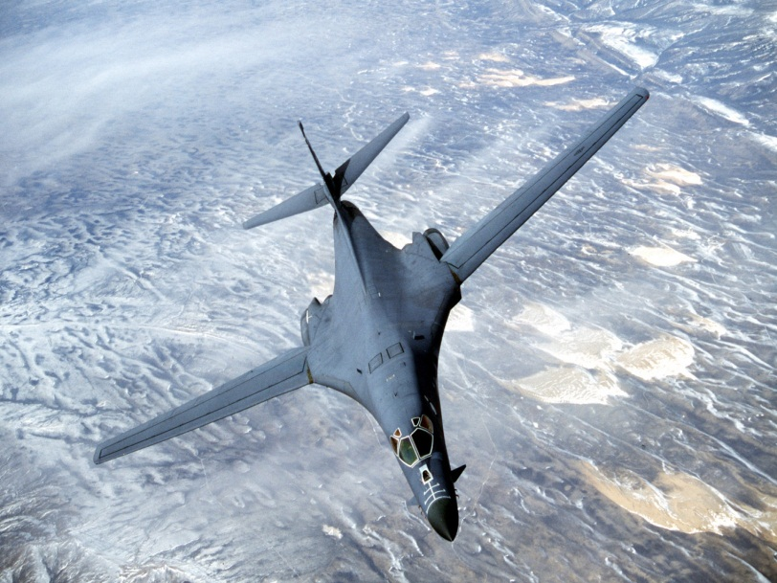
B1-B Lancer
Supersonic Heavy Bomber

Slide 25
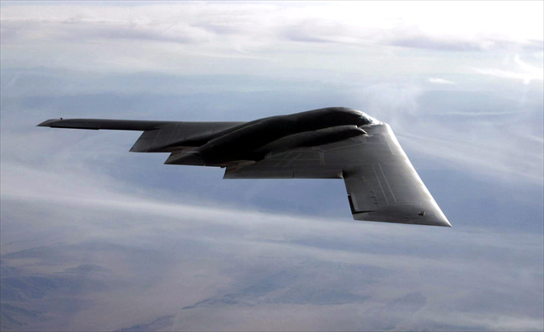
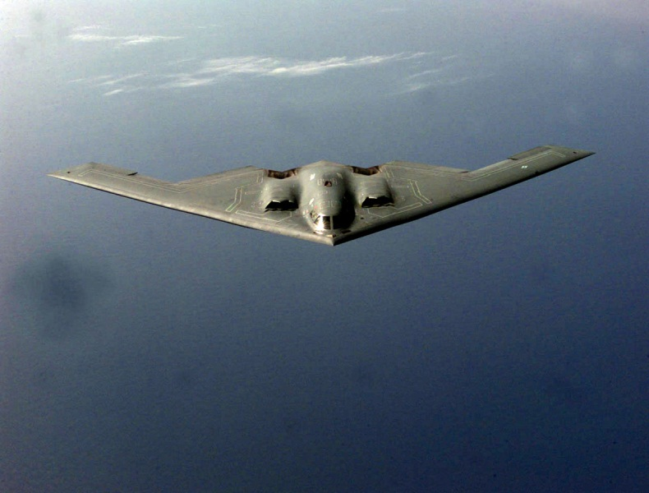
B-2 Spirit
Stealth
Conventional/
Nuclear/Precision
GPS-aided Munitions

Slide 26
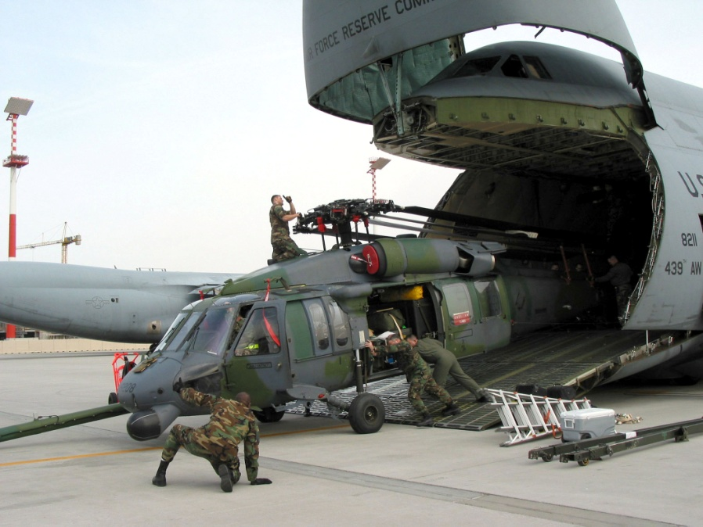
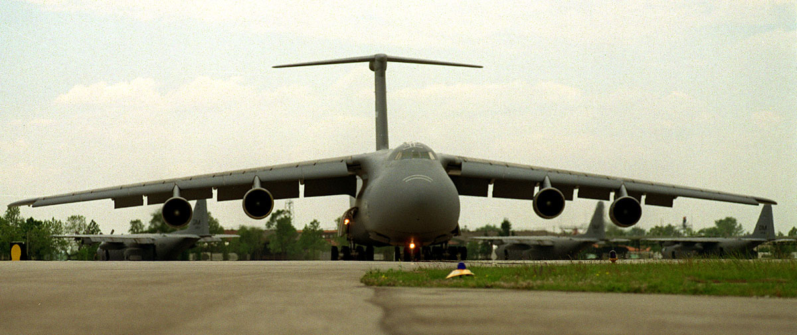
C-5 Galaxy
Largest in DoD
Heavy Equipment
Long Range Transport

Slide 27
C-17 Globemaster III
Advanced Avionics
CONUS to Battlefield
Extremely Versatile

Slide 28
KC-135 Stratotanker
Backbone of the Tanker Force
Boom or Drogue Refueling
(unless wing pods are installed -- then, both are possible)

Slide 29
KC-10 Extender
Dual-Role Tanker and Cargo
Boom and Drogue Refueling

Slide 30
Summary
Selected air and space systems used in AFEX
A. Mission
B. Characteristics

